Slide 1
Cryptography-based Image/Video Steganography for more secure data hiding

Slide 2
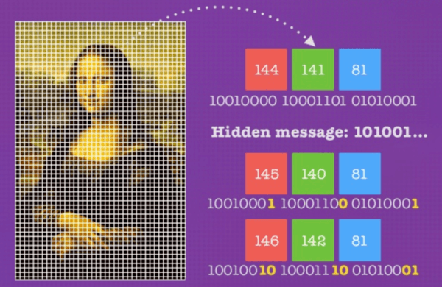
What is steganography?
The term “stegano” is Greek for “hidden” or “covered,” and the “graph” is Greek for “to write.” Put these words together, and we’ve got something close to “hidden writing,” or “secret writing.”
Steganography is the practice of hiding a secret message inside of (or even on top of) something that is not secret.

Slide 3
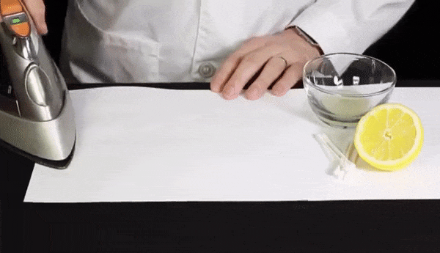
Steganography in its simplest form
Performing the invisible ink with lemon juice demonstration is fairly straightforward. Simply dip the cotton swab into the lemon juice and write your message on a piece of paper. The lemon juice “ink” will dry relatively clear and “invisible.” Once it dries, you can apply heat to the paper to make the message appear and turn brown.

Slide 4
How Steganography Is Used Today?
Steganography can be a way which makes it possible to send news and information without being censored and without the fear of the messages being intercepted and traced back to us.
Today, hackers use PowerShell and BASH scripts to automate attacks. So are pen testers. For example, attackers have been embedding actual scripts within macro-enabled Excel and Word documents. Once a victim opens the Excel or Word doc, they activate the embedded, secret script.
Steganography can be used for digital watermarking in which a message (being simply an identifier) is hidden in an image so that its source can be tracked or verified

Slide 5
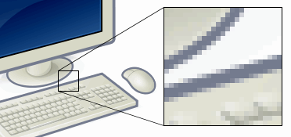
How to hide data in image/video?
LSB (Least Significant Bit) METHOD
What is a digital image?
We can describe a digital image as a finite set of digital values, called pixels. Pixels are the smallest individual element of an image, holding values that represent the brightness of a given color at any specific point. So we can think of an image as a matrix (or a two-dimensional array) of pixels which contains a fixed number of rows and columns. which are basically a dot matrix data structure, representing a grid of pixels, which in turn can be stored in image files with varying formats.

Slide 6
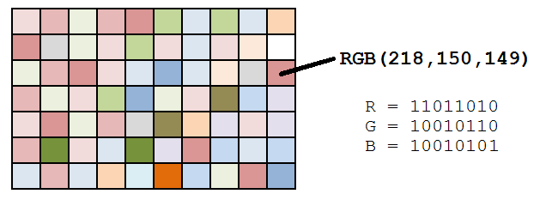
So, each pixel from the image is composed of 3 values (red, green, blue) which are 8-bit values (the range is 0–255).
As we can see in the image, for each pixel we have three values, which can be represented in binary code (the computer language).

Slide 7
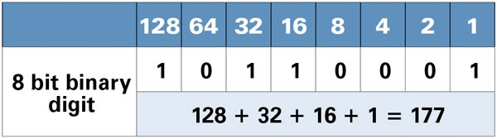
When working with binary codes, we have more significant bits and less significant bits, as you can see in the image below.
The leftmost bit is the most significant bit. If we change the leftmost bit it will have a large impact on the final value. For example, if we change the leftmost bit from 1 to 0 (11111111 to 01111111) it will change the decimal value from 255 to 127.
the rightmost bit is the less significant bit. If we change the rightmost bit it will have less impact on the final value. For example, if we change the leftmost bit from 1 to 0 (11111111 to 11111110) it will change the decimal value from 255 to 254. Note that the rightmost bit will change only 1 in a range of 256 (it represents less than 1%).

Slide 8
Each pixel has three values (RGB), each RGB value is 8-bit (it means we can store 8 binary values) and the rightmost bits are less significant. So, if we change the rightmost bits it will have a small visual impact on the final image. This is the steganography key to hide an image inside another. Change the least significant bits from an image and include the most significant bits.
Since we understood the pixel concept and color models, we can talk about the procedure of hiding data inside video.

Slide 9
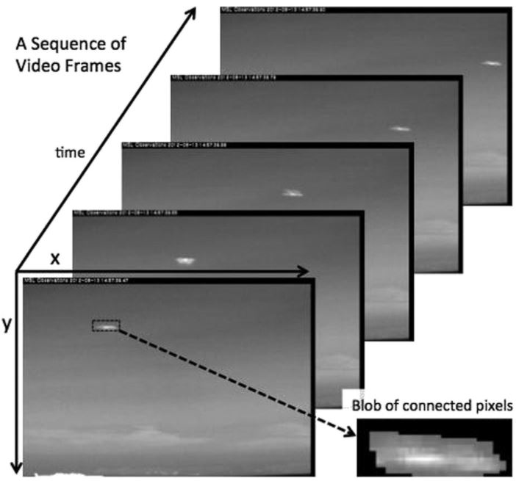
What is a video?
A video is a sequence of images called frames. Each frame is a two-dimensional grid of pixels or single image.

Slide 10

A video is a collection of frames, and each frame is an image. So if we pull out all the frames from a video, we can use this method to store our data using LSB steganography and stitch those frames back into a video with the secret message.

Slide 11
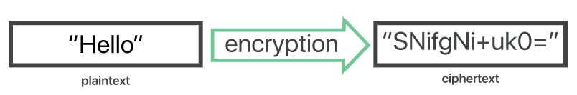
Encrypting the data for more secure data hiding.
What is Encryption?
Encryption is a way of scrambling data so that only authorized parties can understand the information. In technical terms, it is the process of converting human-readable plaintext to incomprehensible text, also known as ciphertext. In simpler terms, encryption takes readable data and alters it so that it appears random. Encryption requires the use of a cryptographic key: a set of mathematical values that both the sender and the recipient of an encrypted message agree on.

Slide 12
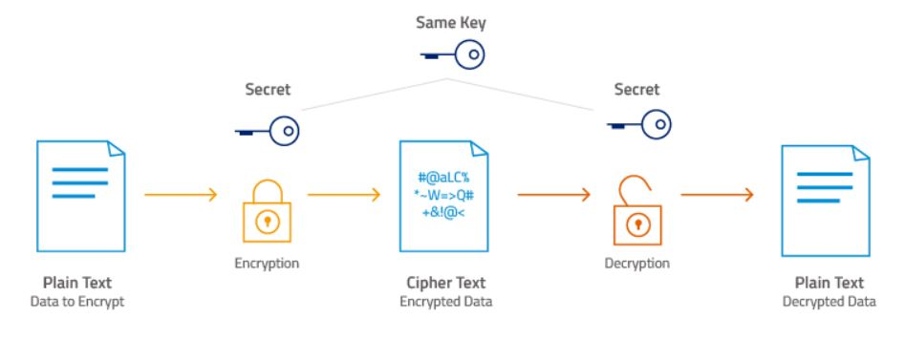
AES-256 encryption
AES-256, which has a key length of 256 bits, supports the largest bit size and is practically unbreakable by brute force based on current computing power, making it the strongest encryption standard.

Slide 13
How does AES 256 work?
AES is a symmetric key cipher. This means the same secret key is used for both encryption and decryption, and both the sender and receiver of the data need a copy of the key.
The data to be encrypted (known as plaintext) is divided into sections called blocks. AES uses a 128-bit block size, in which data is divided into a four-by-four array containing 16 bytes. Since there are eight bits per byte, the total in each block is 128 bits. The size of the encrypted data remains the same: 128 bits of plaintext yields 128 bits of ciphertext.

Slide 14
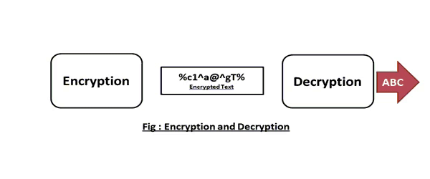
The basic principle of all encryption is that each unit of data is replaced by a different one according to the security key. More specifically, AES was designed as a substitution-permutation network. AES brings additional security because it uses a key expansion process in which the initial key is used to come up with a series of new keys called round keys. These round keys are generated over multiple rounds of modification, each of which makes it harder to break the encryption.

Slide 15
Implementation using python
The lsb-method steganography and cryptography is implemented using python because of its vast library and support of developers across the globe
Easy to implement
We have divided the project into two parts:
1. Encoding (or Sender module)
2. Decoding (Or receiver module)

Slide 16
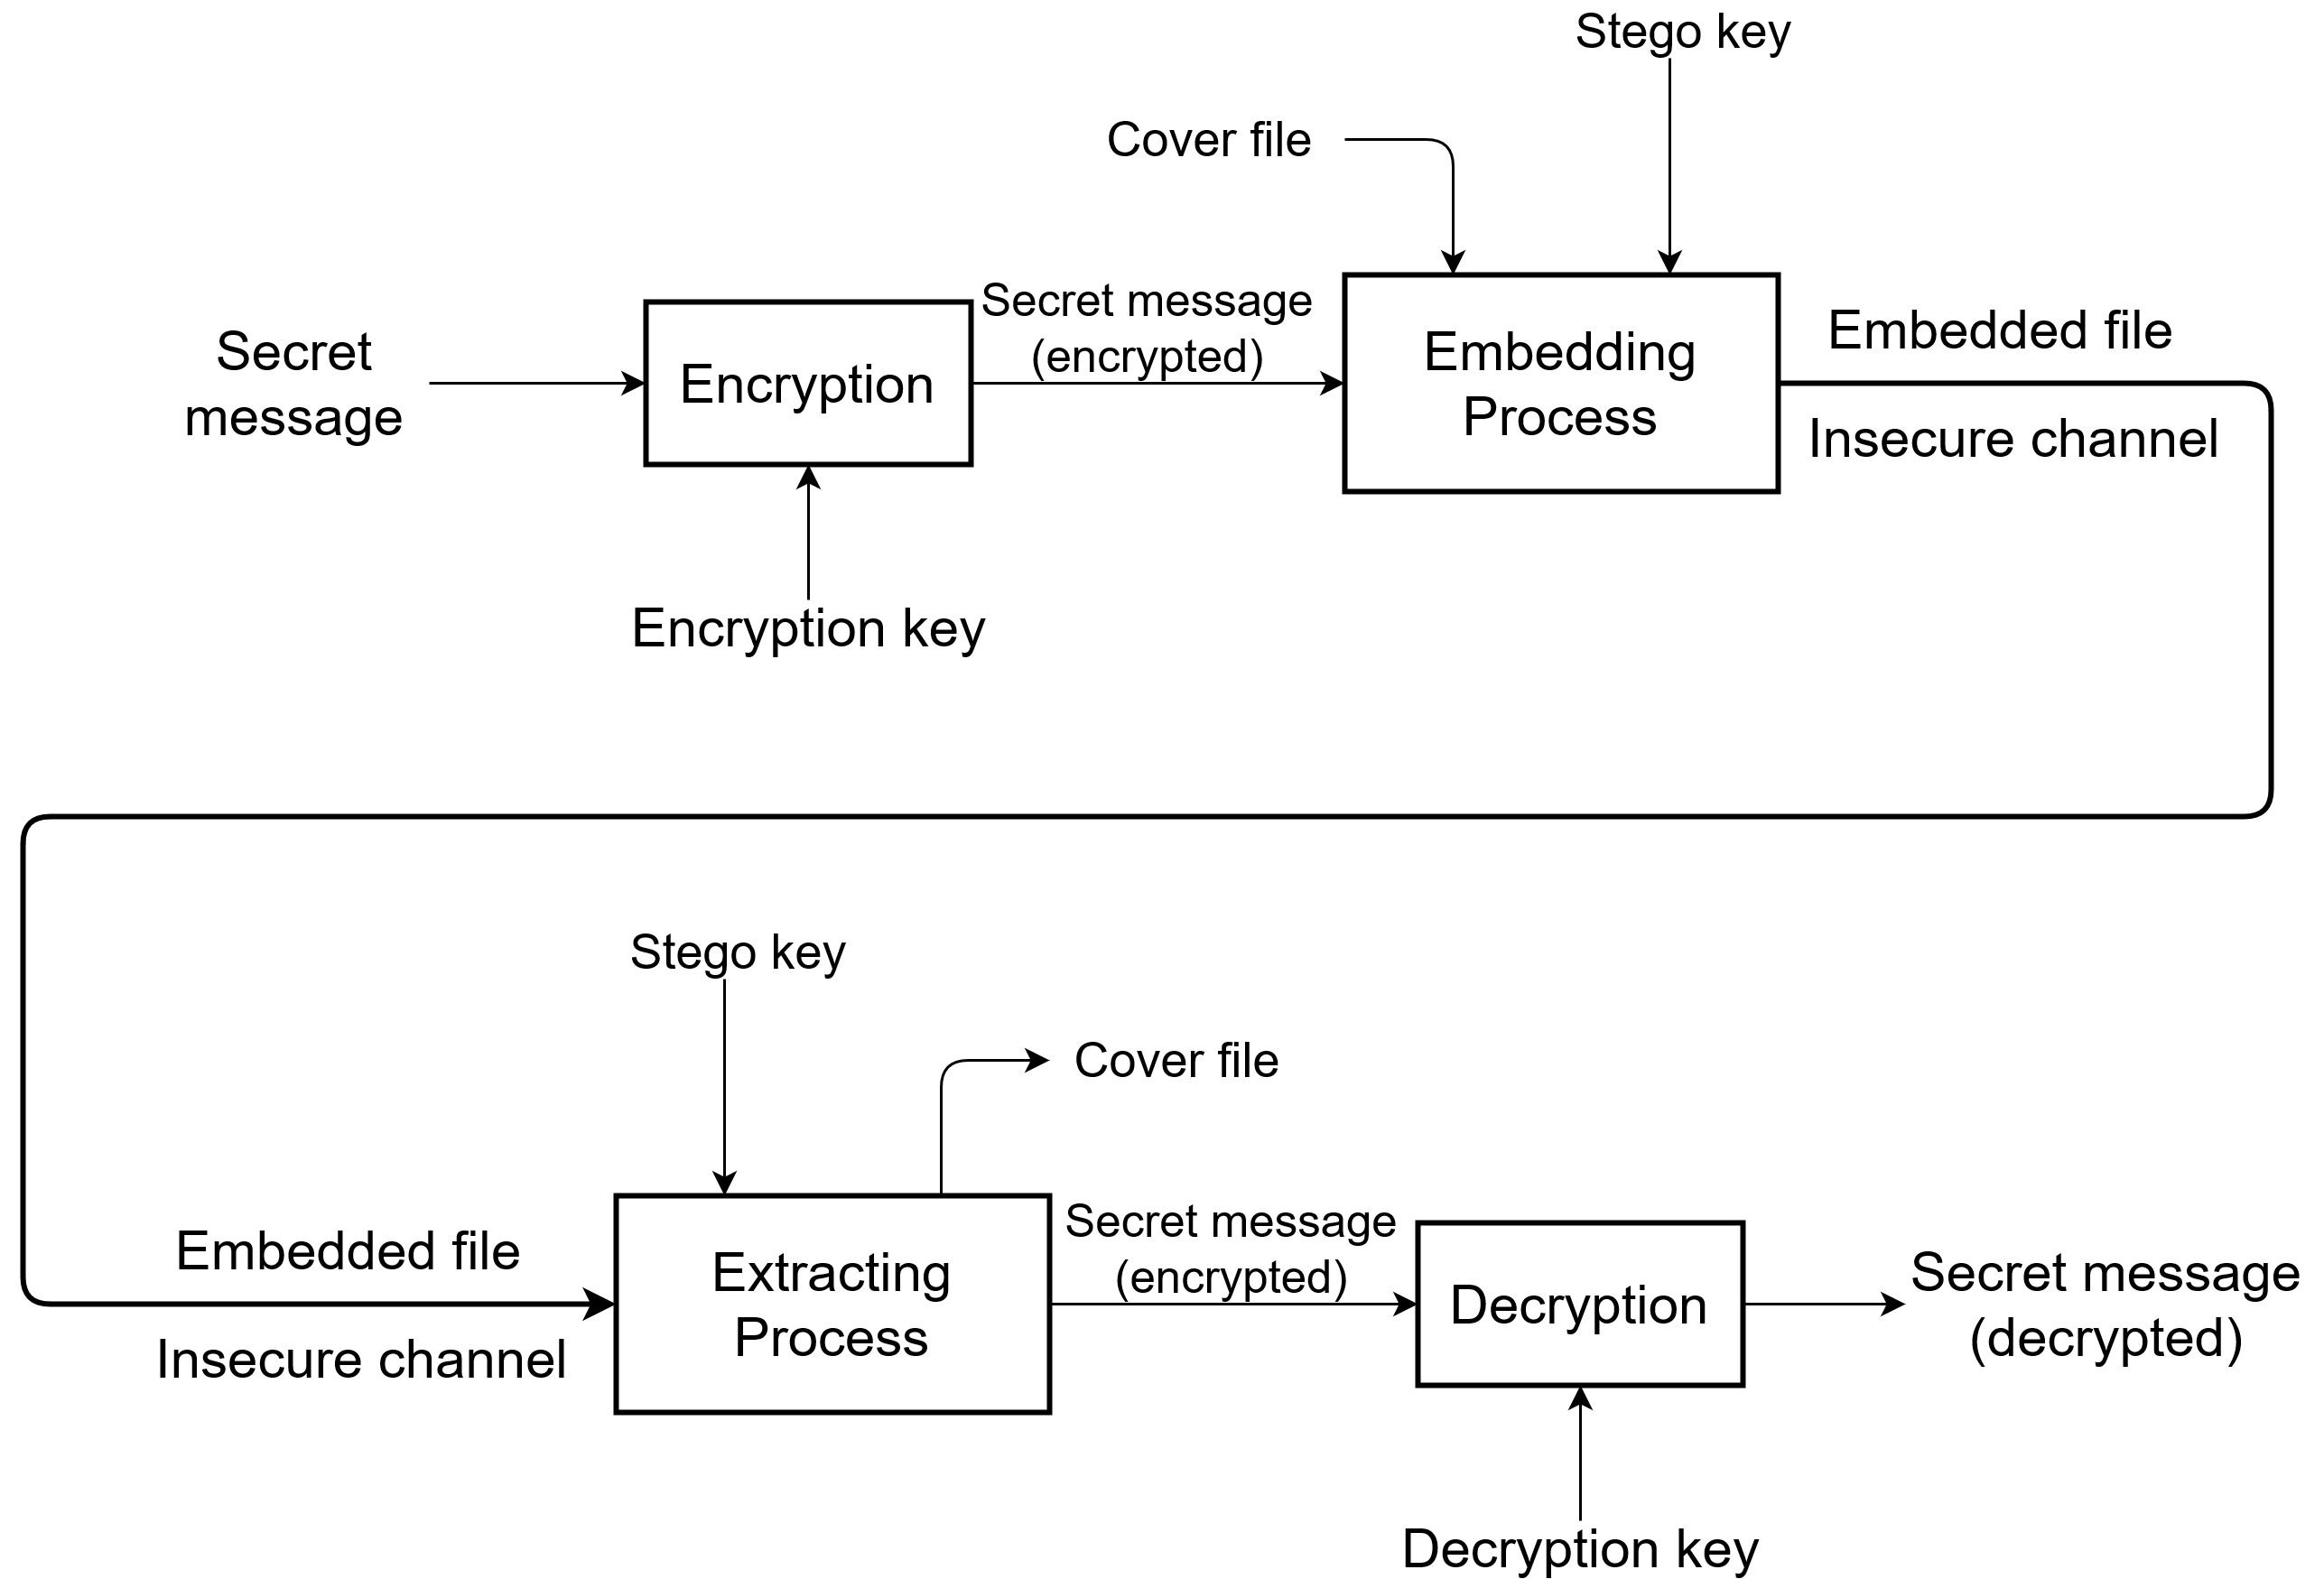

Slide 17
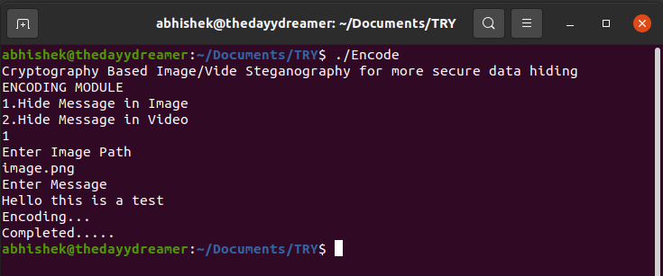
Encoding module
Procedure for Image Steganography:
Run the encode.elf (linux executable) on terminal
A drop-down menu is given
Select from the given options Image or Video
Embedding the message/data in image

Slide 18
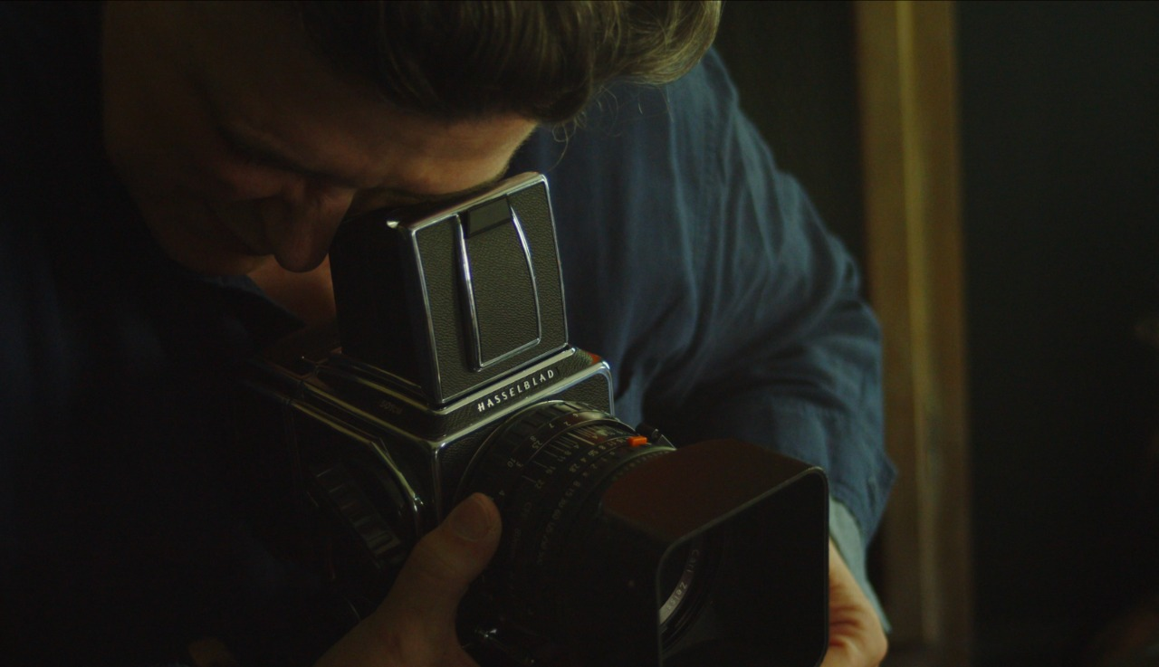
RESULT
A NEW EMBEDDED IMAGE IS GENERATED WITH HIDDEN DATA/MESSAGE WITH NO NOTICABLE DIFFERENCE
Original Image
Embedded Image

Slide 19
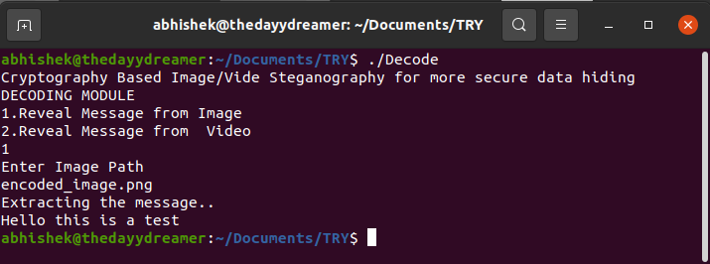
Message/data extraction
Procedure for message extraction from image
Run the decode.elf (decoding module)
Select the Image option from drop-down menu

Slide 20
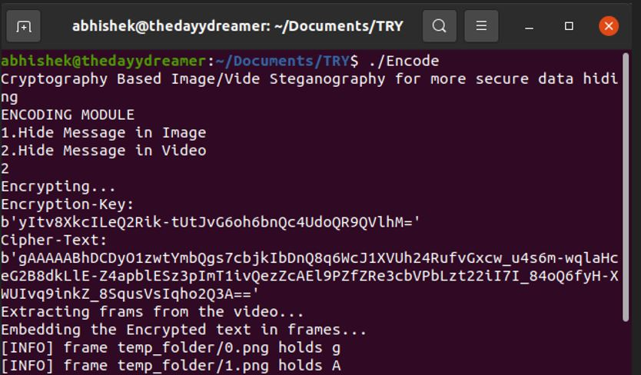
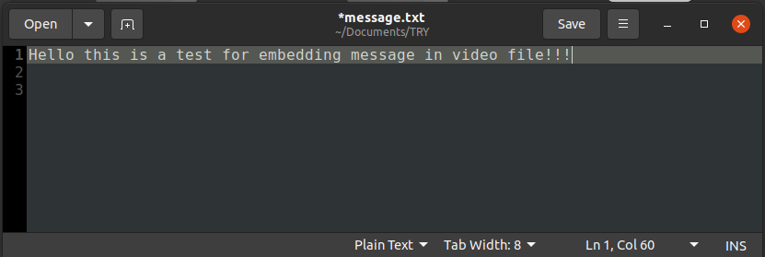
Procedure for video steganography
Run the encode module again
Select video option from drop down menu
Save the message in a file named message.txt
Select the video

Slide 21
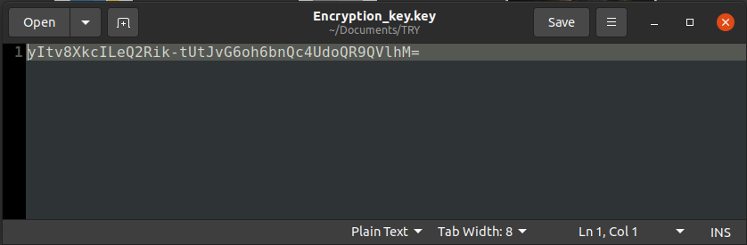
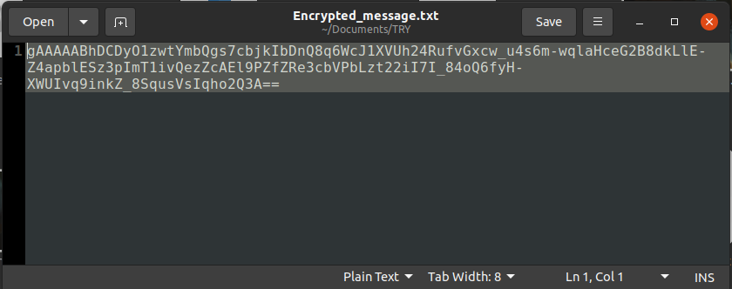
An Encryption key file is generated “encryption_key.key”
This encryption key is essential for message extraction
With the help of this key a encrypted message is generated with is then further embedded into the video file.

Slide 22
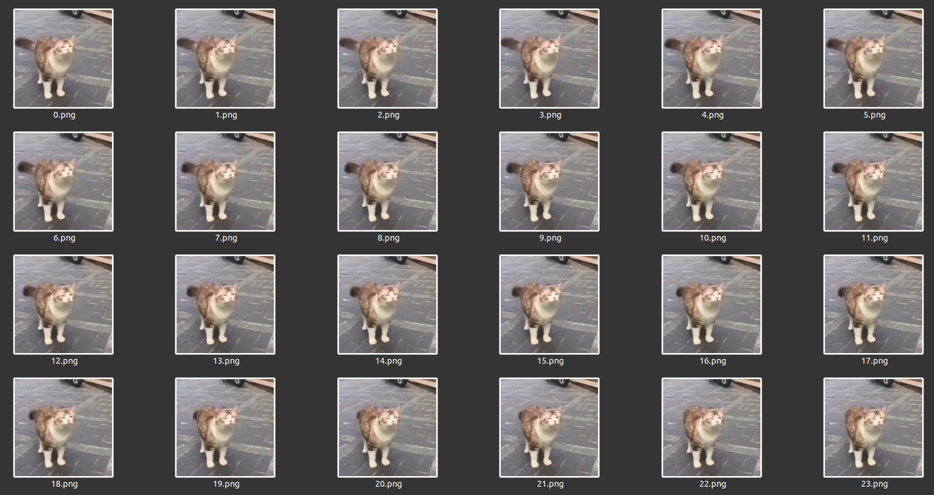
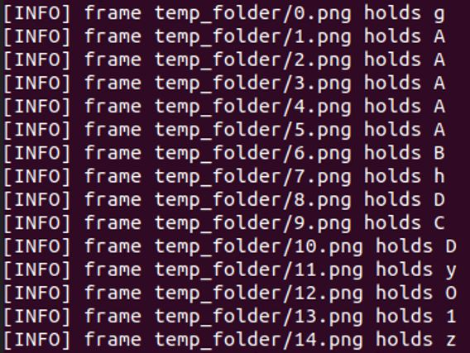
Frames Extraction and message embedding
Extracted Frames
Message/Data Embedding

Slide 23
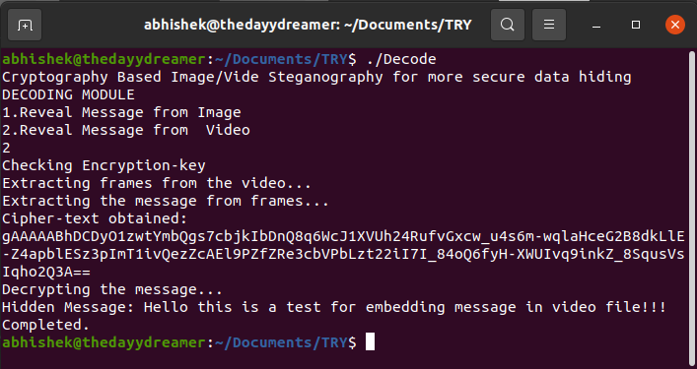
Result
A new video file is generated with the embedded message
Procedure for message extraction from video
Run the decode module
Select video option from drop-down menu
Select the encryption key
Embedded message is obtained

Slide 24
Conclusion
Steganography works by hiding information in a way that doesn’t create suspicion.
Lsb (least significant bit) method was used as it changes the least pixel information in the source file.
Cryptography is added for further security and integrity of the message/data.
Steganography, the practice of hiding information, has been around for centuries. And in parallel to technological advances, steganography has also evolved and adapted with the advent of computers and the internet.

Slide 25
References
Web Help:
WWW.wikipedia.org/
www.researchgate.net/
www.britannica.com/
www.academia.edu/
A Review Paper on Video Steganography IEEE, 2016 by Dr. Arjun Nichal
Video Steganography: Secure Data Hiding Techniques I. J. Computer Network and Information Security, 2017
Colour Image Steganography Based on Pixel Value Differencing in Spatial Domain, IEEE, 2018
Research Papers on steganography

Slide 26
THANK You
Submitted BY:
Rahul Kumar [1784110038]
Akshay saroj [1784110010]
Sarthak katiyar [1784110046]
Abhishek kumar [1784110003]

